Slide 1
Collection Week 4

Slide 2
On Gathering
Why gather
How to gather
Ways to do it

Slide 3
Why Gather?
Notes:
Ask them

Slide 4
Why Gather?
Not being done!
Make the world better
Make something you care about last
Because otherwise someone else will do it instead/in spite of you

Slide 5
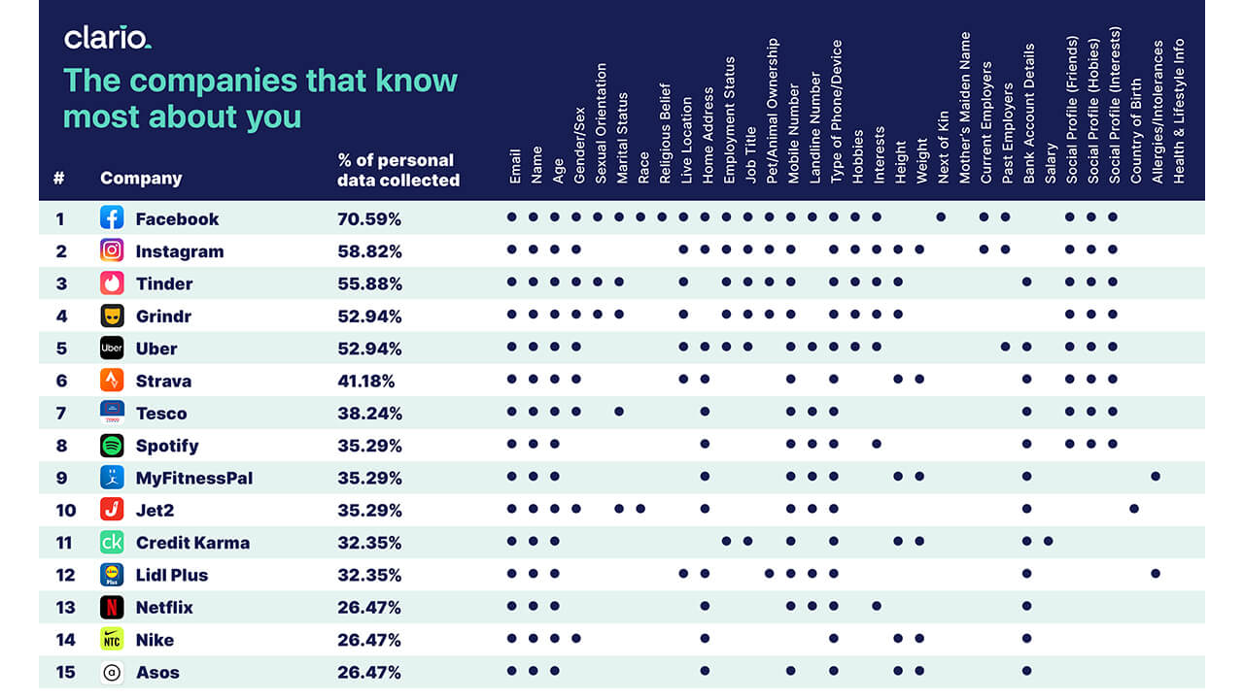
How to Gather – Passively

Slide 6
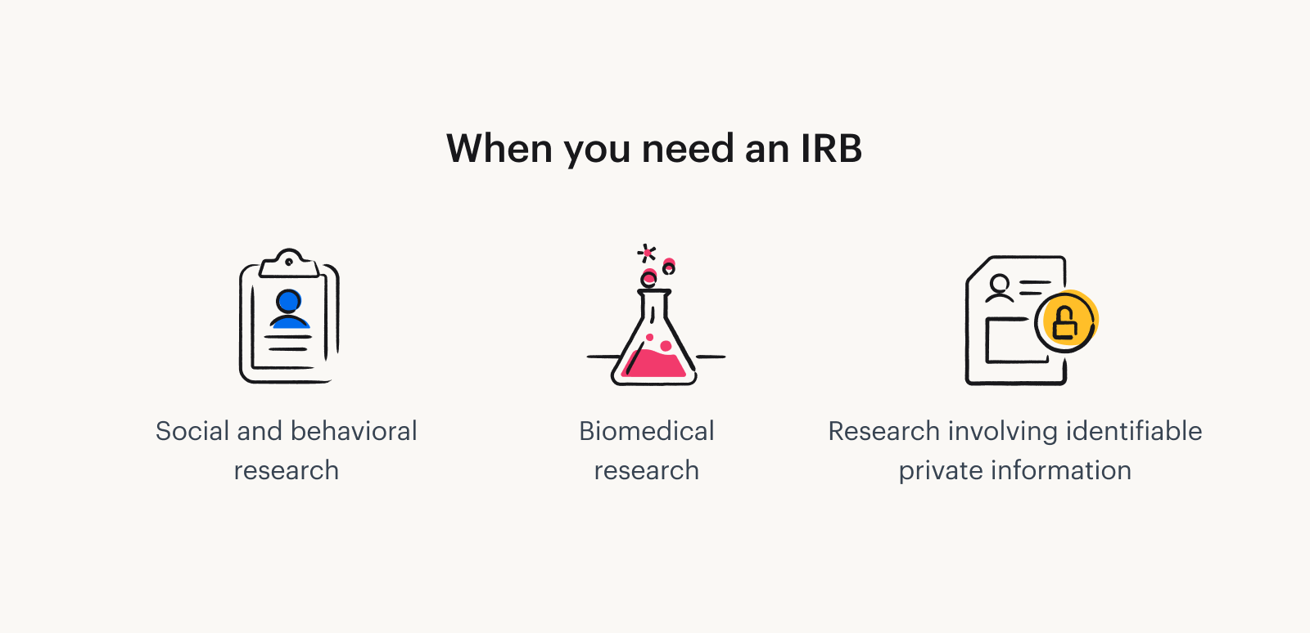

How to Gather - Ethics
Notes:
https://www.tremendous.com/blog/
https://www.google.com/imgres?q=irb&imgurl=https%3A%2F%2Fwww.nsula.edu%2Fwp-content%2Fuploads%2FScreen-Shot-2022-09-01-at-11.16.17-AM.png&imgrefurl=https%3A%2F%2Fwww.nsula.edu%2Fnsu-irb-announces-changes-updates%2F&docid=ktE_eJUmjLq1NM&tbnid=1F-_7zA2Um8I6M&vet=12ahUKEwiMjsD4lKOKAxUYMVkFHWdrBKcQM3oECBgQAA..i&w=4014&h=1688&hcb=2&ved=2ahUKEwiMjsD4lKOKAxUYMVkFHWdrBKcQM3oECBgQAAwhat-is-an-irb-and-what-purpose-does-it-serve/

Slide 7
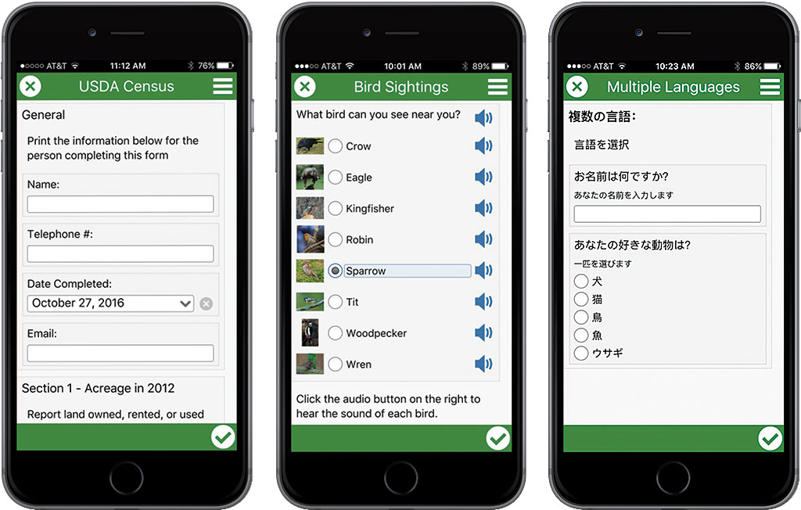
Ways to Gather - Individually
Survey 123 (at right)
Google forms
Can pull directly into spreadsheet
Direct interviews
Best practice is to compensate subjects
Notes:
https://www.esri.com/about/newsroom/arcuser/5-reasons-to-use-survey123-for-arcgis/

Slide 8
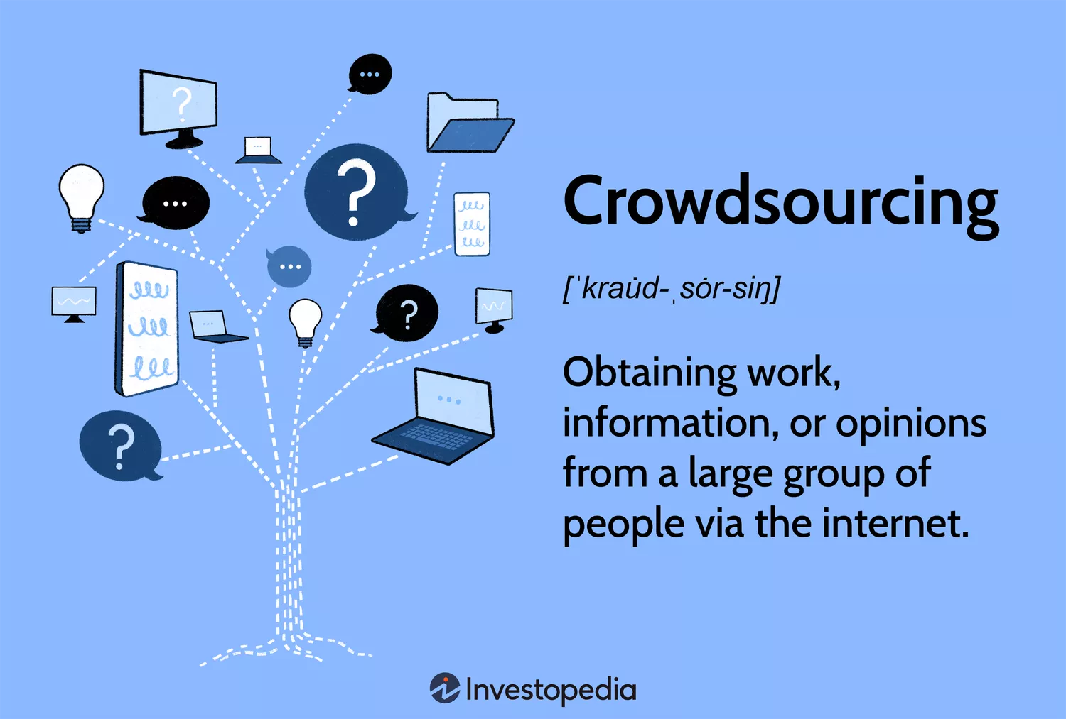

Ways to Gather - Crowdsourcing
Notes:
https://www.investopedia.com/terms/c/crowdsourcing.asp

Slide 9
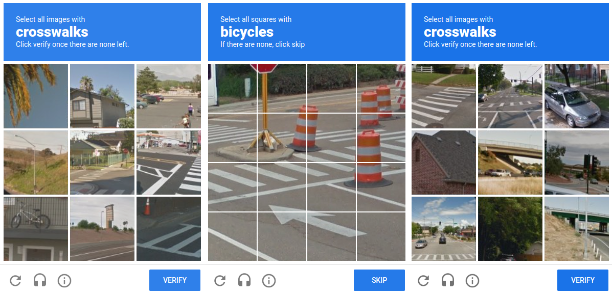
Notes:
What is this? What are you doing when you click it? recaptcha

Slide 10
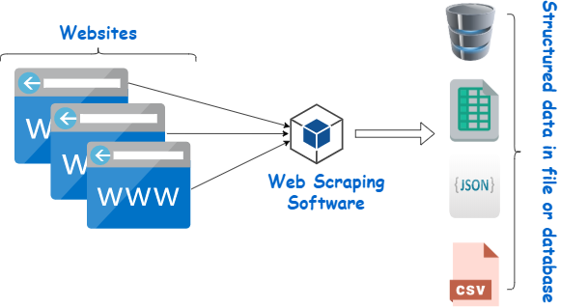
How to Gather – Web Scraping
Notes:
https://www.webharvy.com/articles/what-is-web-scraping.html

Slide 11
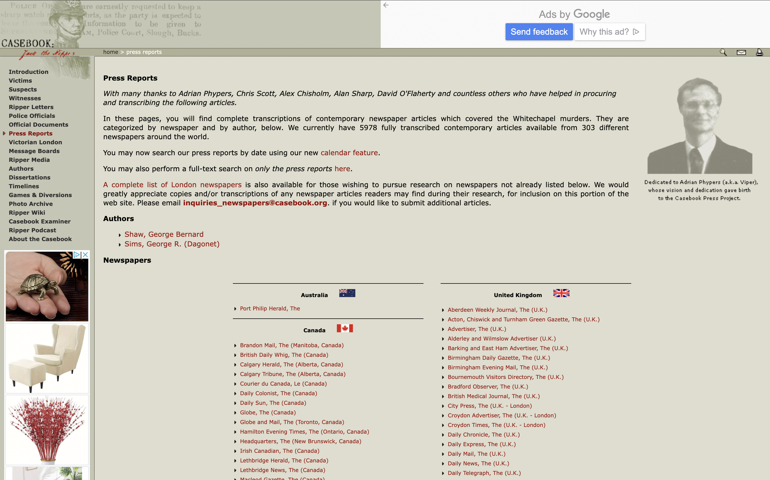
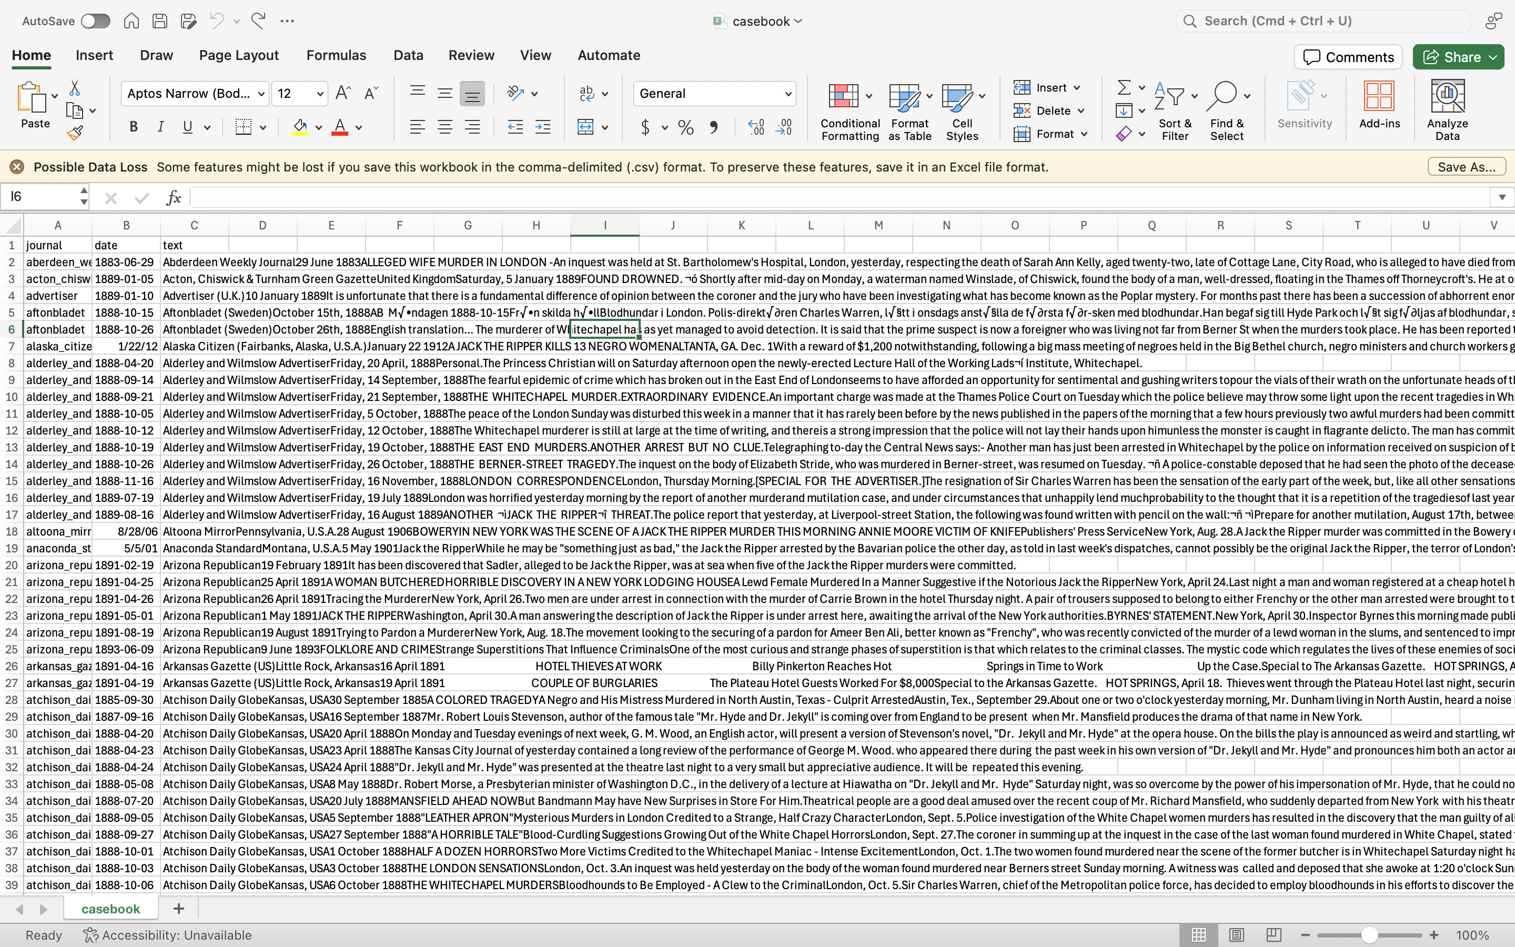
How to Gather – Web Scraping
Notes:
https://www.webharvy.com/articles/what-is-web-scraping.html

Slide 12
Workshop on webscraper.io
Take them through scraping the Scholars' Lab website.
Show them how to export a webpage

